Slide 1
Formatting Dialogue
Writer’s Notebook – Notes Section

Slide 2
What is Dialogue?
Dialogue is a conversation between people.
Today we’re going to look at how to format and punctuate dialogue so the reader can easily understand it.

Slide 3
Why Use Dialogue?
Dialogue isn’t just for breaking up the narration or making your characters talk. It’s kind of pointless to include a conversation like this:
“Hi,” Michael said.
“Hi,” Brittany said. “How are you?”
“I’m good. How are you?”
“I’m fine. Did you have a good weekend?”
“Yes. Did you?”
“Yes, thanks for asking.”

Slide 4
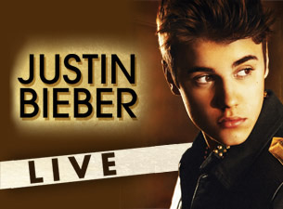
Why Use Dialogue?
Your dialogue should be meaningful. It should have a reason for existing.
For example, the dialogue could move the plot forward:
“I have an extra ticket for the Justin Bieber concert tonight,” Michael said. “Do you want to go with me?”
“Sure!” Brittany said. “This is the coolest thing ever!”

Slide 5
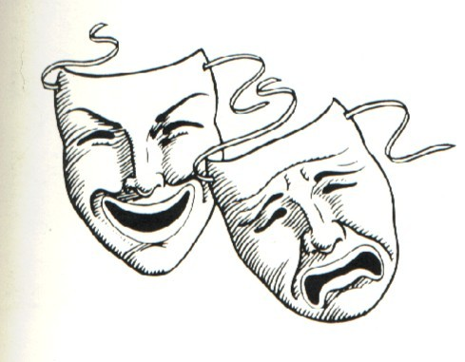
Why Use Dialogue?
You can also use dialogue to reveal something about a character:
“I didn’t think I would be able to find anyone to go with me,” Michael said. “Good things never happen to me.”
“That’s crazy!” Brittany exclaimed. “Your life is wonderful!”

Slide 6
Punctuation
Quotation marks (“ ”) go around the spoken part.
A comma ( , ) separates the sentence from its tag, ‘Michael said’
The period ( . ) goes at the end of the sentence.
“I’m the biggest Justin Bieber fan in the world,” Michael said.

Slide 7
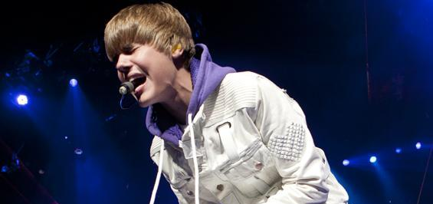
Punctuation
Multiple sentences may go into the quote.
“I have all of his albums, and I know every lyric by heart. Seeing him in concert last year was the highlight of my life,” Michael added.

Slide 8
Punctuation
If the quote ends with a question or an exclamation, put ? or ! inside the quotation mark, instead of a comma. The period still goes at the END.
“Do you really think you’re a bigger fan than I am?” Brittany asked.
“Of course I am!” Michael yelled.

Slide 9
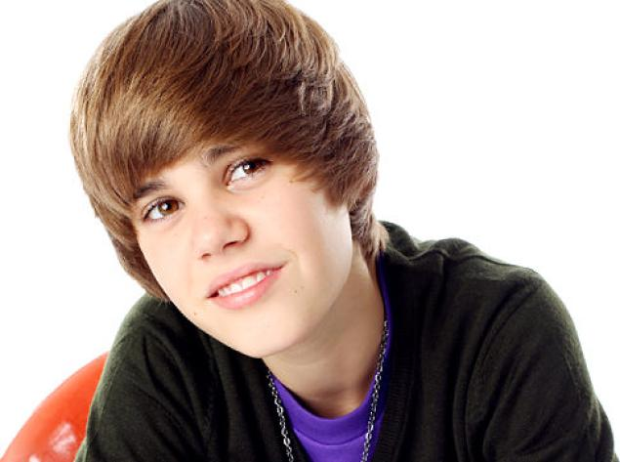
Punctuation
Quoting a quote: use single quotes to indicate the spoken portion.
“I bet you only know the hit singles, like ‘Baby’ and ‘Boyfriend,’” Brittany said.
“That’s ridiculous – he even called me a ‘superfan’ when I met him backstage,” Michael argued.

Slide 10
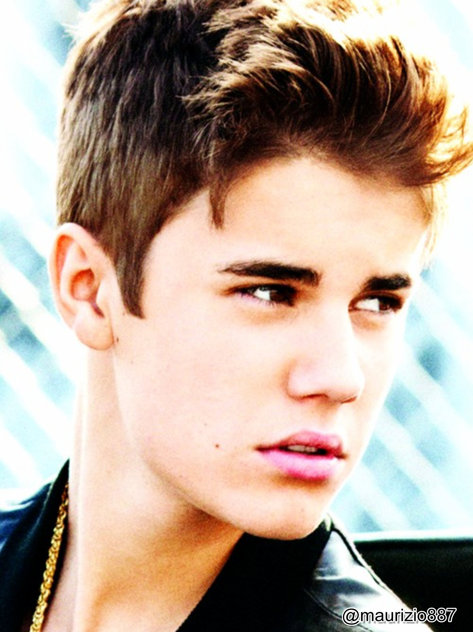
Tag
Tag: identifies the speaker and how it is said.
You can put the tag in the beginning, middle, or end of the sentence.
If the tag is in the middle of ONE sentence, use commas to separate it from the sentence.
“I can’t believe you’d even try to argue,” Brittany said, “that you’re a bigger Belieber than I am.”

Slide 11
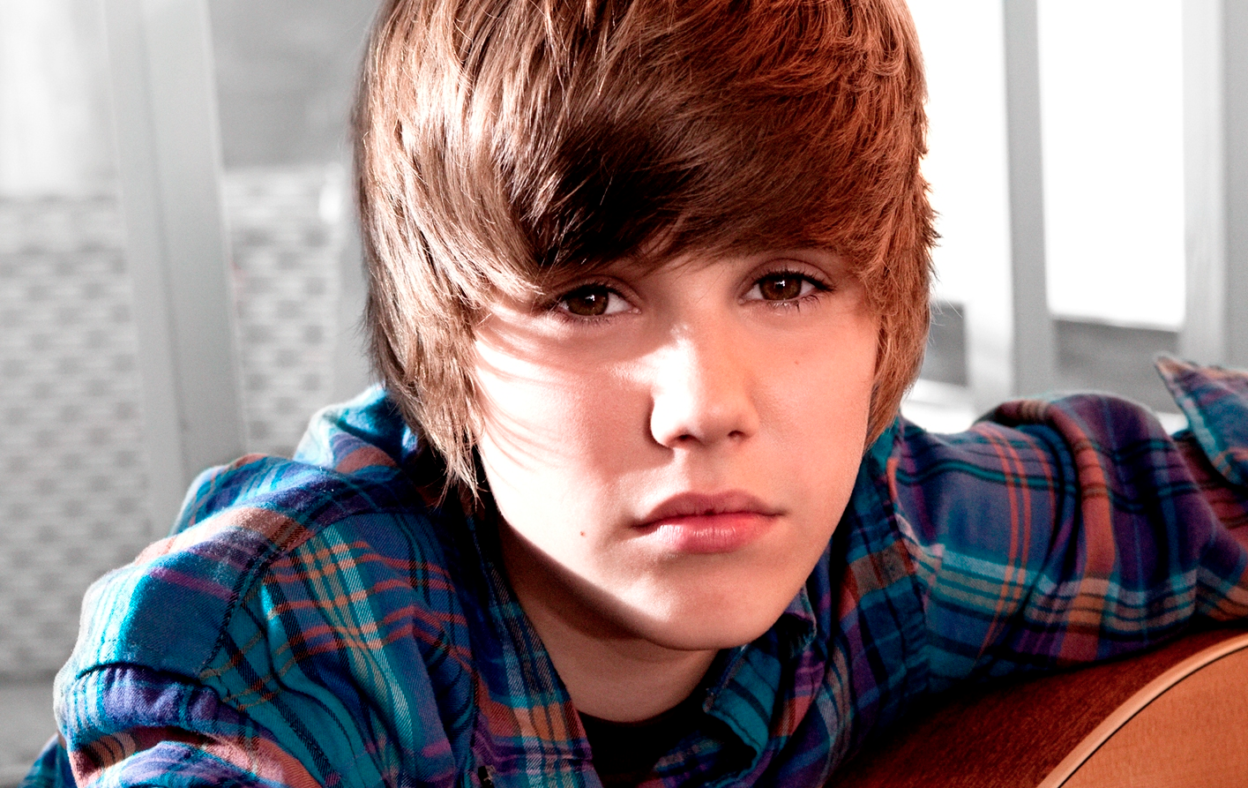
Tag
If the tag is in the middle of TWO sentences, use a period.
“I’m not arguing with you,” Michael said. “It’s an undisputed fact.”

Slide 12
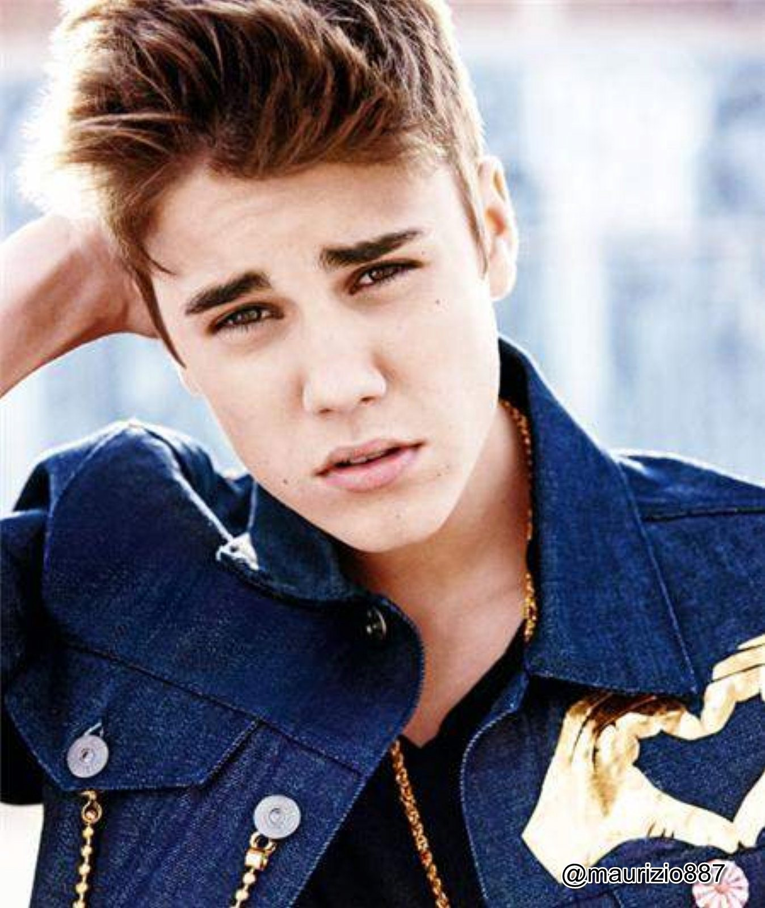
Changing Speakers
Every time someone different speaks, start a new paragraph.
This means you should start a next line AND indent.
Do this even if the person only says one word.
“You’re just jealous,” Brittany said.
“Wow.”
“This is all because I have a signed Bieber bobblehead, and you don’t.”

Slide 13
Dialogue Sample
“I don’t need your stupid bobblehead to prove I’m the biggest Bieber fan in the world,” Michael said. “I loved him before he was cool.”
“That’s so not true! You didn’t know who he was until I told you about him!” Brittany exclaimed.
“Are you kidding?” Michael asked. “I was watching him on YouTube before Usher discovered him!”
Brittany shouted, “You’re such a liar!”
“Wow, this is ridiculous.”

Slide 14
Add Description
“I don’t need your stupid bobblehead to prove I’m the biggest Bieber fan in the world,” Michael said. He rolled his eyes at Brittany. “I loved him before he was cool.”
“That’s so not true! You didn’t know who he was until I told you about him!” Brittany exclaimed.
“Are you kidding?” Michael asked angrily. He crossed his arms. “I was watching him on YouTube before Usher discovered him!”
Brittany gasped and shouted, “You’re such a liar!”
“Wow, this is ridiculous.”

Slide 15
Removing Tags
If a sentence of description replaces the tag, each full sentence should stand alone.
“Justin Bieber signed my bobblehead,” Brittany said.
BECOMES
“Justin Bieber signed my bobblehead.” Brittany pointed to it up on her shelf.
OR
“Justin Bieber signed my bobblehead.” Brittany pointed to it up on her shelf. “It’s my most valuable possession.”

Slide 16
Writing Thoughts
When you write a character’s thoughts, use italics instead of quotation marks.
With Brittany gone, Michael was left alone with his thoughts. What if I am just jealous of Brittany’s bobblehead? It does look pretty awesome.

Slide 17
Review Time!
You and your partner should have a whiteboard and a marker.
You can discuss the answers quietly, but don’t give them away to anyone around you! Leave your whiteboard down on your desk until I ask for everyone to show their answers.

Slide 18
Dialogue Review
“She said” or “he answered” are examples of:
scripts
tags
actor’s lines
characters

Slide 19
Dialogue Review
“She said” or “he answered” are examples of:
scripts
tags
actor’s lines
characters

Slide 20
Dialogue Review
______ is when two or more characters talk to each other in a book or play:
script
dialogue
quotation
description

Slide 21
Dialogue Review
______ is when two or more characters talk to each other in a book or play:
script
dialogue
quotation
description

Slide 22
Dialogue Review
What punctuation mark identifies dialogue?
comma
period
italics
quotation marks

Slide 23
Dialogue Review
What punctuation mark identifies dialogue?
comma
period
italics
quotation marks

Slide 24
Dialogue Review
How do you know when the speaker changes?
You start a new paragraph.
You use a comma.
It is separated.
You don’t know.

Slide 25
Dialogue Review
How do you know when the speaker changes?
You start a new paragraph.
You use a comma.
It is separated.
You don’t know.

Slide 26
Dialogue Review
Which of the following are correct?
“I love Justin Bieber” Brittany explained.
“I love Justin Bieber.” Brittany whispered.
“I love Justin Bieber,” Brittany announced.
“I love Justin Bieber!” Brittany shouted.
“I love Justin Bieber?” Brittany asked.
“I love Justin Bieber?” Brittany asked?

Slide 27
Dialogue Review
Which of the following are correct?
“I love Justin Bieber” Brittany explained.
“I love Justin Bieber.” Brittany whispered.
“I love Justin Bieber,” Brittany announced.
“I love Justin Bieber!” Brittany shouted.
“I love Justin Bieber?” Brittany asked.
“I love Justin Bieber?” Brittany asked?

Slide 28
Dialogue Review
Which of the following are correct?
Brittany looked at the picture and smiled, “He’s so cute.”
Brittany looked at the picture and smiled. “He’s so cute.”
Brittany looked at the picture, smiled, and said, “He’s so cute.”
Brittany looked at the picture, smiled, and said “He’s so cute.”

Slide 29
Dialogue Review
Which of the following are correct?
Brittany looked at the picture and smiled, “He’s so cute.”
Brittany looked at the picture and smiled. “He’s so cute.”
Brittany looked at the picture, smiled, and said, “He’s so cute.”
Brittany looked at the picture, smiled, and said “He’s so cute.”

Slide 30
Dialogue Review
Which of the following is correct?
“I think Justin Bieber” Michael said “is the best singer of all time.”
“I think Justin Bieber” Michael said, “is the best singer of all time.”
“I think Justin Bieber,” Michael said. “is the best singer of all time.”
“I think Justin Bieber,” Michael said, “is the best singer of all time.”

Slide 31
Dialogue Review
Which of the following is correct?
“I think Justin Bieber” Michael said “is the best singer of all time.”
“I think Justin Bieber” Michael said, “is the best singer of all time.”
“I think Justin Bieber,” Michael said. “is the best singer of all time.”
“I think Justin Bieber,” Michael said, “is the best singer of all time.”

Slide 32
Dialogue Review
Which of the following is correct?
“Bieber is the best,” Brittany added “He should totally be president.”
“Bieber is the best,” Brittany added, “he should totally be president.”
“Bieber is the best,” Brittany added. “He should totally be president.”

Slide 33
Dialogue Review
Which of the following is correct?
“Bieber is the best,” Brittany added “He should totally be president.”
“Bieber is the best,” Brittany added, “he should totally be president.”
“Bieber is the best,” Brittany added. “He should totally be president.”

Slide 34
Dialogue Review
Which of the following are correct?
“My mom said, ‘That’s the worst music I’ve ever heard,’” Michael mumbled.
“My mom said, “That’s the worst music I’ve ever heard,” Michael mumbled.
“My mom said that it’s the worst music she’s ever heard,” Michael mumbled.
“My mom said that ‘it’s the worst music she’s ever heard,’” Michael mumbled.

Slide 35
Dialogue Review
Which of the following are correct?
“My mom said, ‘That’s the worst music I’ve ever heard,’” Michael mumbled.
“My mom said, “That’s the worst music I’ve ever heard,” Michael mumbled.
“My mom said that it’s the worst music she’s ever heard,” Michael mumbled.
“My mom said that ‘it’s the worst music she’s ever heard,’” Michael mumbled.

Slide 36
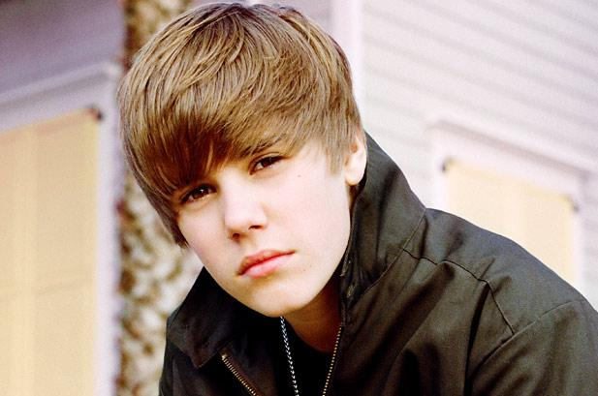
Time to Write!
Write a one-page story in your Writer’s Notebook using correctly formatted dialogue.*
*Your story does not have to be about Justin Bieber.

